Slide 1

Spam Detection
using Text Analytics
PROJECT BASED EXPERIENTIAL LEARNING
BY SEJAL YADAV

Slide 2
PROBLEM STATEMENT
Spam messages are unsolicited and harmful messages distributed through email, SMS, and online platforms.
Challenges:
Large volume of messages
Manual filtering is inefficient
Spam messages constantly evolve
Goal:
Develop a machine learning based spam detection system using text analytics techniques to automatically classify messages into Spam or Ham (Non-Spam)

Slide 3
DATASET AND TOOLS
Dataset
SMS Spam Collection Dataset
Contains ~5572 labeled messages
Two classes:
  Spam
  Ham
Technologies Used
Python
Jupyter Notebook
Libraries:
  NumPy
  Pandas
  Scikit-learn
  NLTK

Slide 4
STEPS
Before training the model, the raw text data is processed.
Steps involved:
Tokenization
Splitting sentences into individual words.
Lowercasing
Convert all text to lowercase to maintain uniformity.
Stopword Removal
Removing common words (the, is, and, etc.).
Stemming / Lemmatization
Reducing words to their root form.
Feature Extraction
  Count Vectorizer
  TF-IDF (Term Frequency – Inverse Document Frequency)
This converts text into numerical feature vectors.

Slide 5
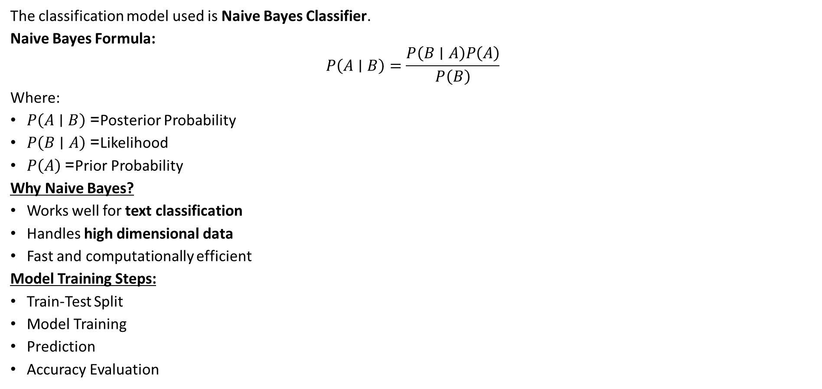
MACHINE LEARNING MODEL
The classification model used is Naive Bayes Classifier.
Naive Bayes Formula:
$$P\left(A∣B\right)=\frac{P\left(B∣A\right)P\left(A\right)}{P\left(B\right)}$$
Where:
$P\left(A∣B\right)$= Posterior Probability
$P\left(B∣A\right)$= Likelihood
$P\left(A\right)$= Prior Probability
Why Naive Bayes?
Works well for text classification
Handles high dimensional data
Fast and computationally efficient
Model Training Steps:
Train-Test Split
Model Training
Prediction
Accuracy Evaluation

Slide 6
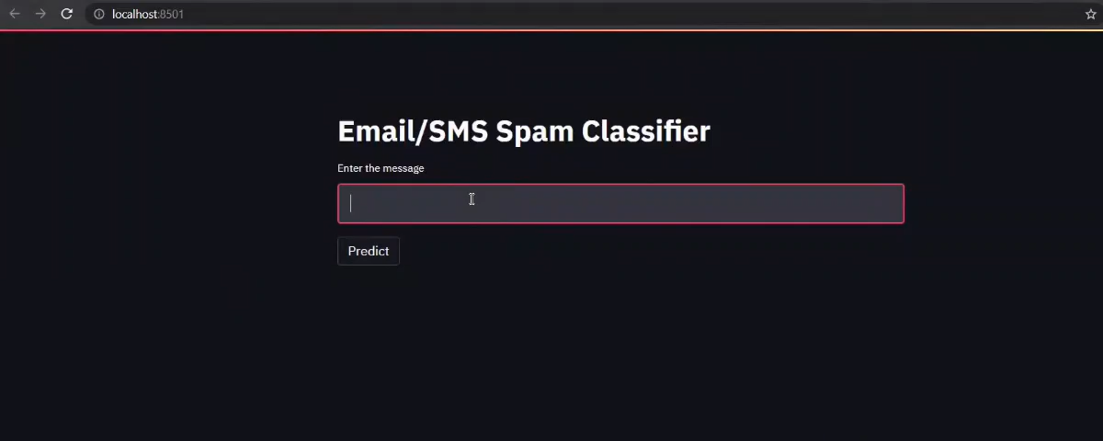
DEMO OF THE PROJECT

Slide 7
RESULTS AND CONCLUSION
Results
Accuracy achieved: ~96–98%
Efficient classification of spam messages
Reduced false positives
Conclusion
Text analytics combined with machine learning effectively detects spam messages.
Naive Bayes classifier provides high performance for text-based classification tasks.
Future Improvements
Use Deep Learning (LSTM / Transformers)
Implement real-time spam detection systems
Apply model to email filtering systems

Slide 8
THANK YOU

